Slide 1


WASTE MANAGEMENT
BY- ZEFFTECH
A BEAUTIFUL ENVIRONMENT STARTS WITH US

Slide 2




SMART INDIA HACKATHON 2024
PROBLEM STATEMENT ID: SIH1575
PROBLEM STATEMENT TITLE:- DEVELOPING INNOVATION SOLUTION FOREFFICIENT MANAGEMENT OF WASTE AND CONVERSION TO VALUABLES, WASTE TO ENERGY-WASTE RECYCLING
THEME:- CLEAN & GREEN TECHNOIC
PS CATEGORY:-HARDWARE
TEAM NAME: ZEFFTECH

Slide 3
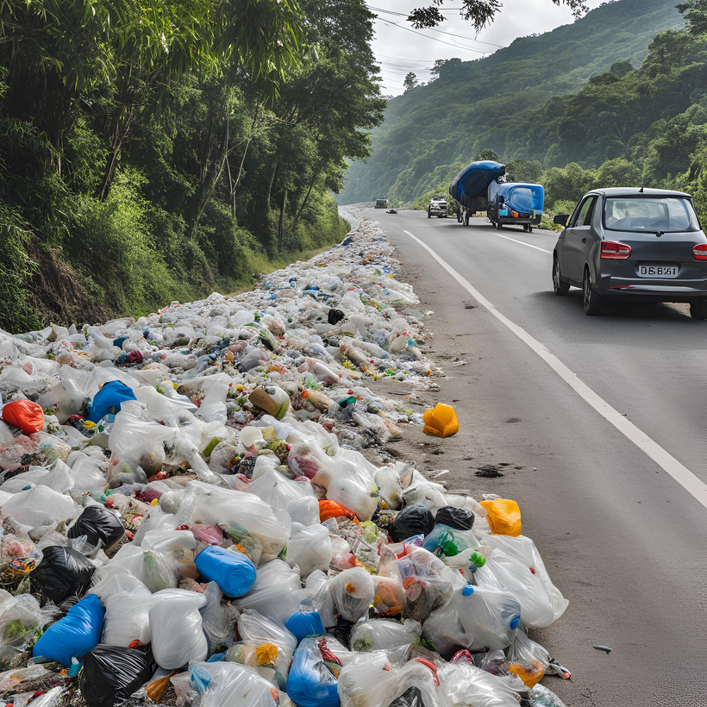
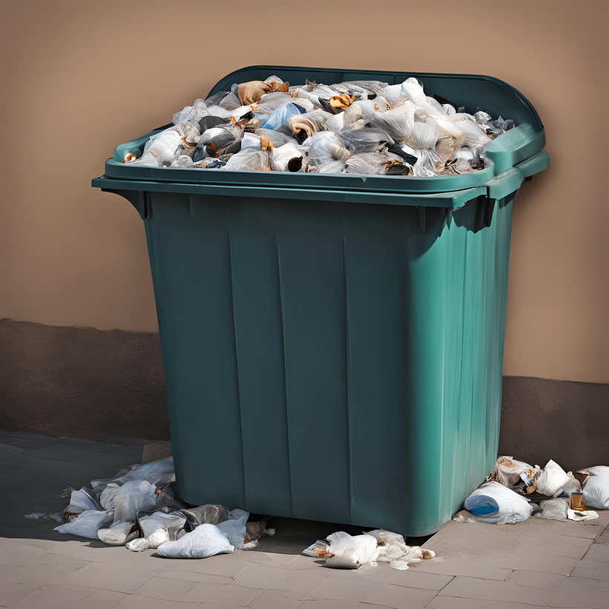
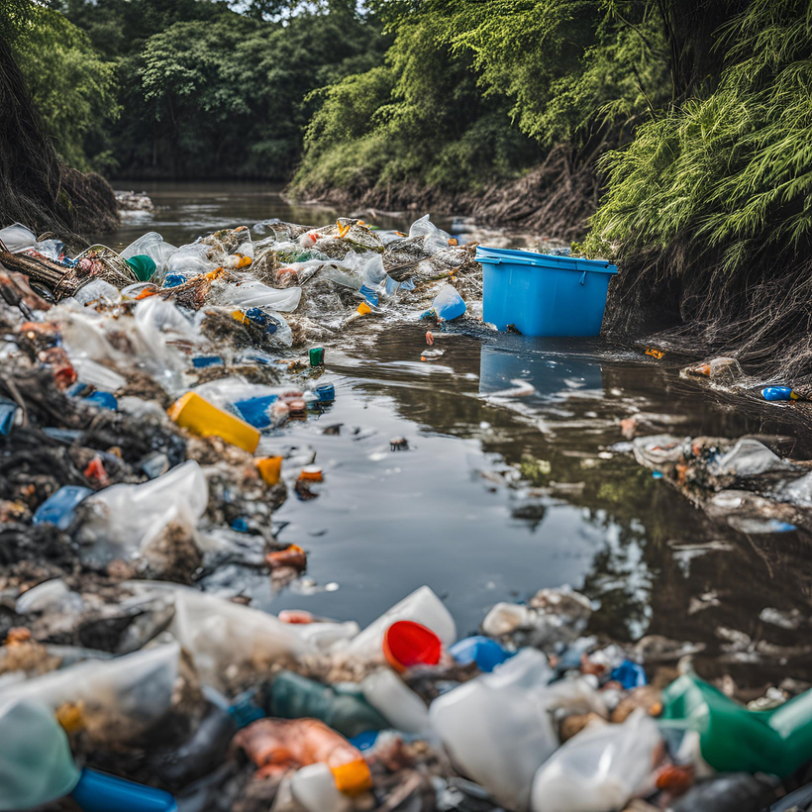
PLASTIC WASTE PROBLEM

Slide 4
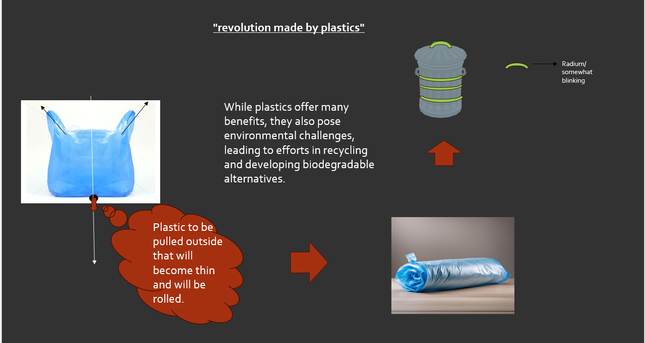
NEW WAY OF USING PLASTIC

Slide 5

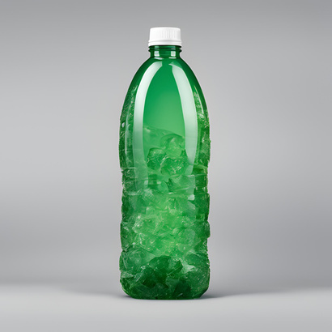
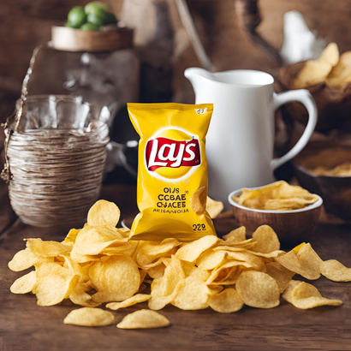
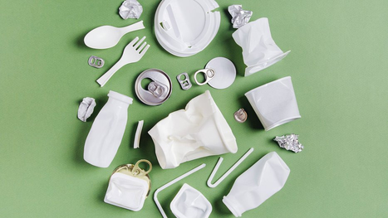
PLASTIC/LAYS PACKETS RELATED
LAYS PACKET
PLASTIC DUSTBIN
SHRINKING
PLASIC BOTTLE
SHRINKED PACKET
DUSTBIN GLOWING TAPE
WISH CAP
MINIMISE WASTE
VOLUME
COMPRESSIBLE BOTTLE

Slide 6


SEEDED CAPS
COMPRESSIBLE BOTTLE

Slide 7
IT CAN REDUCE ITS VOLUME UPTO 60%
WE CAN INCREASE THE AMOUNT OF GARBAGES IN DUSTBIN WITHIN SAME VOLUME

Slide 8
CONCLUSIONS -
IF WE MAKE ALL KINDS OF WASTE COMPACT THEN WE CAN MANAGE WASTE MUCH BETTER

